Slide 1
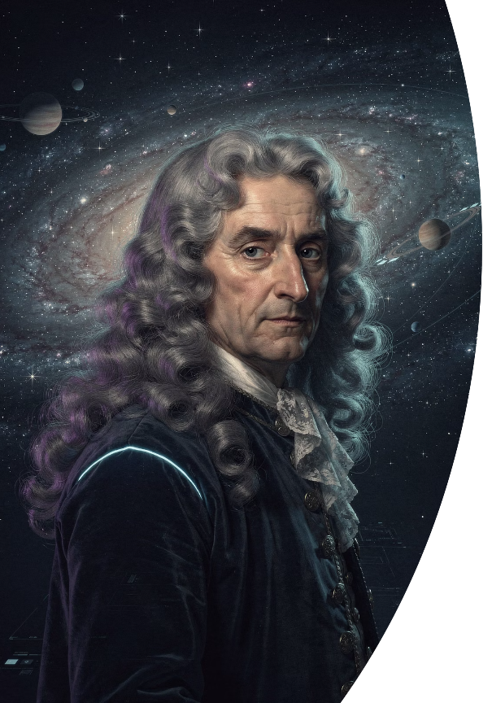
Isaac Newton: The Genius Who Changed the Universe
Explore the extraordinary life and revolutionary discoveries of history's most influential scientist—the man who unlocked the secrets of motion, gravity, and light.

Slide 2
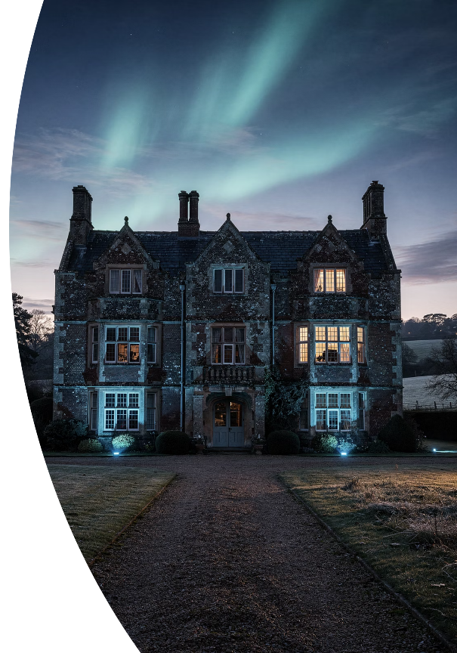

CHAPTER 1
A Fragile Beginning in Turbulent Times
Isaac Newton's journey began in the midst of civil war and uncertainty, a premature infant fighting for survival in a world on the brink of transformation.

Slide 3
Born Premature on Christmas Day, 1642
A Fragile Start
Woolsthorpe Manor
A Nation in Turmoil
Born so tiny he could fit into a quart mug, baby Isaac was barely expected to survive his first days. His premature birth became the first of many obstacles he would overcome.
Arrived into the world at Woolsthorpe Manor in rural Lincolnshire, England—a modest farmhouse that would later witness his greatest breakthroughs during the plague years.
England was torn by civil war between Royalists and Parliamentarians, while plague fears haunted every village. Newton entered a world of chaos and uncertainty.

Slide 4
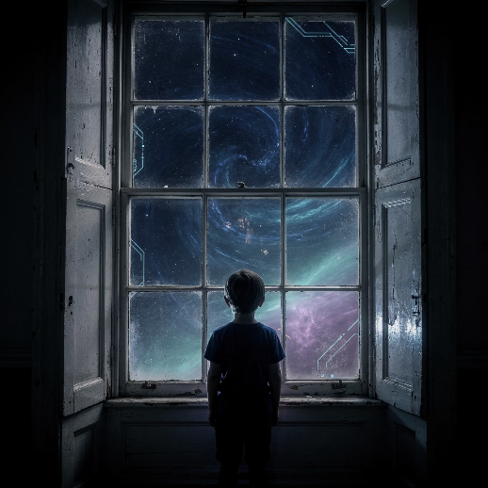
Childhood Shadows: Family Struggles and Solitude
Abandoned by His Mother
Rage and Resentment
Newton's father died three months before his birth. When his mother remarried, she left three-year-old Isaac with his grandmother, creating deep emotional wounds.
Young Newton harbored intense hatred for his stepfather, once threatening to burn down their house. These early traumas shaped his solitary, suspicious nature.
Escape Through Innovation
Finding no comfort in people, Newton sought refuge in mechanics and technology—building windmills, sundials, and water clocks rather than forming friendships.

Slide 5

Woolsthorpe Manor: Where Genius Was Born
This modest Lincolnshire farmhouse witnessed both Newton's difficult childhood and his most productive years during the plague, when he returned home and revolutionized mathematics and physics.

Slide 6
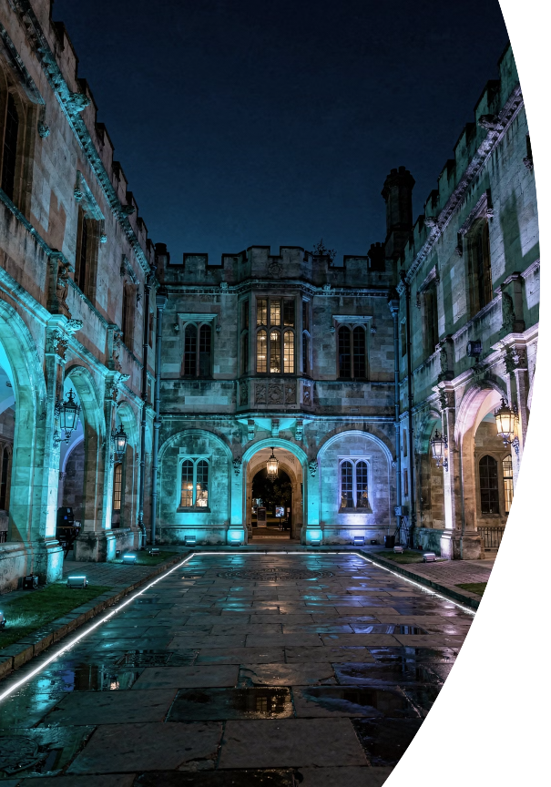

CHAPTER 2
The Making of a Mathematical Mind
Cambridge University became the crucible where Newton's raw intellectual potential was forged into revolutionary genius through mentorship, self-study, and relentless curiosity.

Slide 7
Trinity College, Cambridge: The Crucible of Genius
01
02
Arrival at Cambridge
Mentorship Under Isaac Barrow
In 1661, eighteen-year-old Newton enrolled at Trinity College as a subsizar—a poor student who earned his keep by serving wealthier students. Despite his low status, his brilliance soon became evident.
Newton caught the attention of Isaac Barrow, Cambridge's first Lucasian Professor of Mathematics, who recognized his extraordinary talent and directed him toward the frontiers of mathematical thought.
03
04
Revolutionary Reading
Tackling the Impossible
Newton devoured works by Descartes, Galileo, and Kepler—absorbing their ideas about a mechanical universe governed by mathematical laws, then pushing far beyond their conclusions.
Barrow challenged Newton with unsolved problems in calculus and infinite series. These problems, which had stumped Europe's greatest minds, became Newton's playground for innovation.

Slide 8
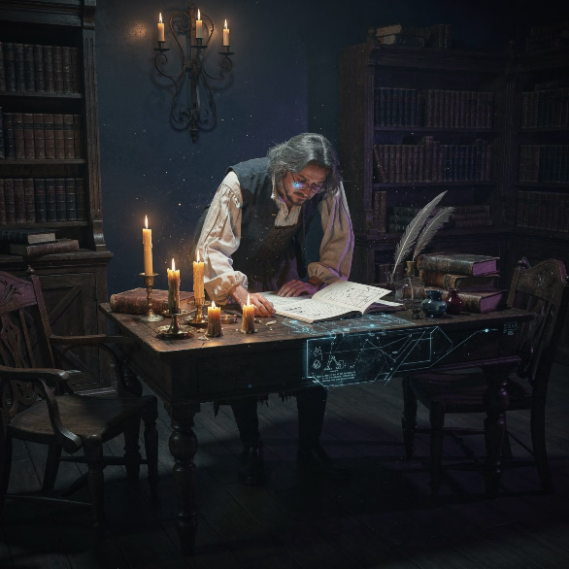
The Plague Years: 1665-1667
Newton's Most Productive Period
When the bubonic plague forced Cambridge to close in 1665, Newton returned to Woolsthorpe Manor. These eighteen months of isolation became the most scientifically productive period in history—his "annus mirabilis" or "year of miracles."
Inventing Calculus
Developed the mathematics of continuous change, creating tools to describe motion and curves with unprecedented precision.
Understanding Gravity
Formulated the universal law of gravitation, explaining why apples fall and planets orbit with a single elegant principle.
Experiments in Optics
Conducted daring experiments with light and color, including the infamous moment when he poked a needle between his eye and socket to study visual perception.

Slide 9


CHAPTER 3
The Apple and the Universal Law of Gravitation
A simple observation about falling fruit sparked one of humanity's greatest intellectual leaps—the realization that the same force governing a falling apple also controls the motion of celestial bodies.

Slide 10



The Falling Apple: Myth and Reality
The Legendary Moment
The Brilliant Connection
Universal Gravitation
According to accounts, an apple falling in his garden prompted Newton to ask: why does it fall straight down? Why not sideways or upward?
Newton realized the same force pulling the apple earthward also pulls the Moon toward Earth—but the Moon's forward motion creates a continuous fall around our planet.
He formulated the Universal Law of Gravitation: every mass attracts every other mass with a force proportional to their masses and inversely proportional to the square of distance between them.
"I began to think of gravity extending to the orb of the Moon... and thereby compared the force requisite to keep the Moon in her orb with the force of gravity at the surface of the Earth."

Slide 11
Newton's Laws of Motion
The Foundation of Classical Physics
First Law: Inertia
Second Law: F=ma
Third Law: Action-Reaction
An object at rest stays at rest, and an object in motion stays in motion at constant velocity, unless acted upon by an external force.
The force acting on an object equals its mass multiplied by its acceleration. This mathematical relationship quantifies how forces change motion.
For every action, there is an equal and opposite reaction. When one object exerts force on another, the second exerts an equal force back.
Objects resist changes to their state of motion.
Force = Mass × Acceleration
Forces always come in pairs.
These three elegant laws, published in Newton's Principia Mathematica (1687), explained everything from projectile motion to planetary orbits, becoming the cornerstone of physics for over two centuries.

Slide 12
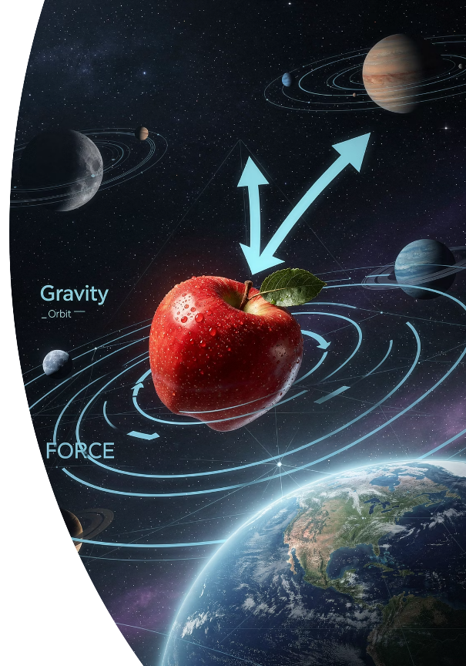
One Force, Infinite Applications
Newton's genius was recognizing that the same gravitational force operates on Earth and in the heavens—unifying terrestrial and celestial mechanics into a single, elegant framework.

Slide 13


CHAPTER 4
Master of Mathematics and Light
Beyond gravity and motion, Newton revolutionized mathematics by inventing calculus and transformed our understanding of light through ingenious experiments that revealed its hidden nature.

Slide 14
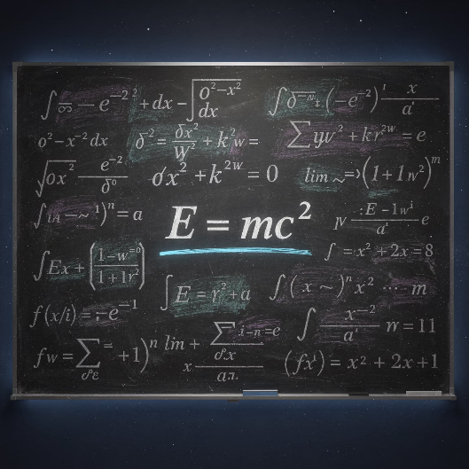
Inventor of Calculus: The Mathematics of Change
Independent Discovery
Newton independently developed calculus alongside German mathematician Gottfried Leibniz, though Newton's work came first (1665-1666). Their bitter priority dispute lasted decades.
Revolutionary Methods
Created the generalized binomial theorem, Newton's method for finding roots, and techniques for infinite series—tools that opened entirely new realms of mathematical analysis.
Universal Impact
Calculus became the essential language for describing continuous change, enabling breakthroughs in physics, engineering, economics, biology, and every field requiring mathematical modeling.
Newton's notation vs. Leibniz's notation: While Newton used dot notation for derivatives, Leibniz's dx/dy notation proved more practical and became the standard still used today.

Slide 15
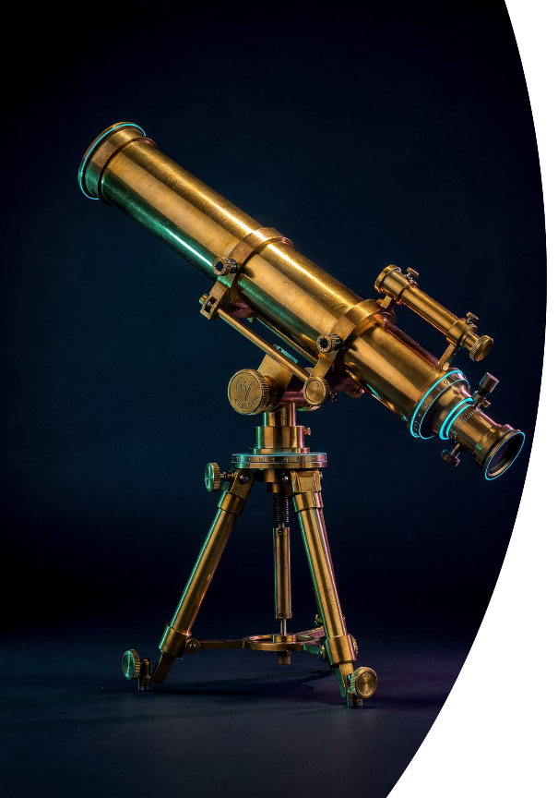
Optics and the Nature of Light
1
1666: Prism Experiments
Newton demonstrated that white light is composed of all colors of the spectrum by passing sunlight through a prism, then recombining the colors back into white light.
2
1668: Reflecting Telescope
Built the first practical reflecting telescope using mirrors instead of lenses, eliminating chromatic aberration that plagued refracting telescopes. This design revolutionized astronomy.
3
1704: Publishing Opticks
Released his comprehensive treatise on light, proposing the corpuscular theory that light consists of particles, exploring diffraction, and laying foundations for modern optics.

Slide 16


CHAPTER 5
The Man Behind the Genius
Behind the towering intellect was a deeply complex individual—brilliant yet tormented, innovative yet obsessive, revolutionary yet consumed by rivalries and ancient mystical pursuits.

Slide 17
Newton's Complex Personality and Rivalries
Monstrous Ego and Paranoia
Newton was known for an enormous ego and pathological need for recognition. He rarely gave credit to others and became deeply paranoid about being cheated of his discoveries, leading to years of bitter feuds.
The Hooke Controversy
His rivalry with Robert Hooke over optics and gravity was so intense that Newton allegedly delayed publishing Principia until after Hooke's death. He systematically worked to erase Hooke's contributions from history.
The Leibniz Dispute
The calculus priority dispute with Gottfried Leibniz became one of history's most bitter scientific controversies. Newton used his position as Royal Society President to orchestrate a biased investigation vindicating himself.
Alchemy and Mysticism
Newton devoted more time to alchemy and biblical chronology than to physics. He wrote over a million words on alchemy, seeking to transmute metals and unlock ancient wisdom—a side of genius often overlooked.

Slide 18




Later Life: Royal Society and the Mint
1703: Royal Society President
Elected President of the Royal Society, Britain's premier scientific institution, a position he held until his death while wielding enormous influence over British science.
1696-1727: Master of the Mint
Served as Warden and then Master of the Royal Mint, personally reforming England's coinage system and prosecuting counterfeiters with ruthless efficiency—sending many to execution.
1705: Knighthood
Queen Anne knighted him, making him Sir Isaac Newton—the first scientist honored for scientific achievement rather than service to the Crown.
Newton's administrative abilities proved as formidable as his scientific genius. At the Mint, he personally interrogated suspects, gathered evidence, and oversaw the Great Recoinage of 1696—preventing economic collapse while dramatically reducing counterfeiting.

Slide 19
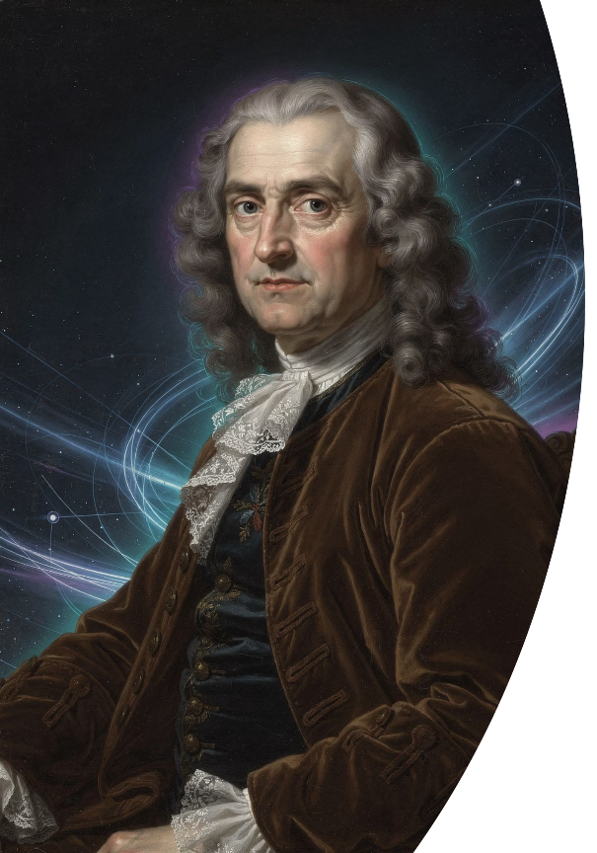
Sir Isaac Newton (1642-1727)
Godfrey Kneller's 1702 portrait captures Newton at the height of his powers—the President of the Royal Society and Master of the Mint, a man who had fundamentally reshaped humanity's understanding of the universe.

Slide 20



Isaac Newton's Legacy
The Architect of Modern Science
Foundation of Modern Physics
Mathematical Revolution
Scientific Method Pioneer
Newton's laws of motion and universal gravitation remained unchallenged for over 200 years until Einstein's relativity. They still govern space travel, engineering, and everyday mechanics with remarkable accuracy.
Calculus transformed mathematics from geometry to analysis, enabling advances in every quantitative field. Modern technology, from smartphones to spacecraft, depends on mathematical tools Newton created.
Newton demonstrated how rigorous mathematics, careful experimentation, and systematic observation could unlock nature's secrets—establishing the template for modern scientific inquiry that continues today.
"If I have seen further it is by standing on the shoulders of Giants."
— Isaac Newton, 1675
Though Newton attributed his success to building on others' work, his towering achievements created the shoulders upon which all subsequent science stands. From quantum mechanics to cosmology, modern physics begins with Newton's revolutionary insights into the fundamental laws governing our universe.

